Slide 1
Data Science Approach for Understanding the History of Weather Extremes of New York City
Stephanie Avila
Gabriella Garcia
Tarendra Lakhankar
Naresh Devineni

Slide 2
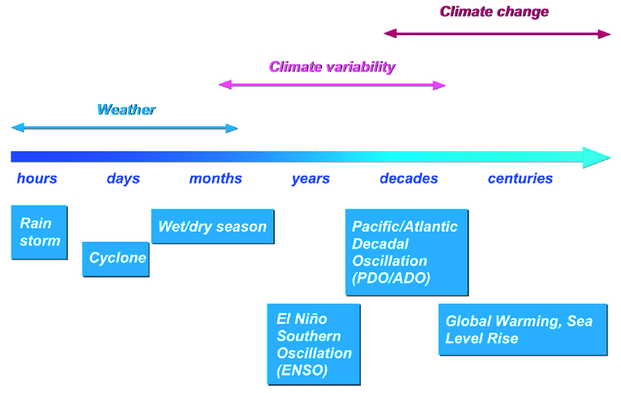
Background
We can see here that weather refers to hours, days and maybe months; climate refers to months, years and decades, and climate change refers to decades and centuries.
We will investigating climate change impact the daily to monthly weather changes in New York City using historical weather stationed data.
Notes:
We can see here that weather refers to hours, days and maybe months; climate refers to months, years and decades, and climate change refers to decades and centuries. Examples of weather are rain storms that might last one or two hours and tropical cyclones that may last days. Climate variability can be defined by climate patterns such as the El-Niño Southern Oscillation and climate change refers to things which happen over centuries, like global warming.

Slide 3
Research Questions
Are the number of hot days/cold days changing over time?
Heat stress days
Are temperatures in New York City different from the surrounding areas?
Impact of Urban Heat Island Effect?
Spatial Variation in temperature?
Monthly variance for each station
Is there a change in the amount of precipitation over time?
Extreme daily rainfall
Number of days with heavy rain
Number of snow days
Wet spells?

Slide 4
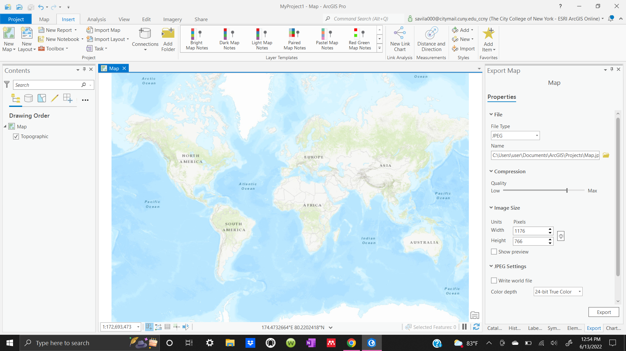
Techniques and Methods
Skills:
Python
Read and process the data
Develop correlation between the data
Re-analyze data
Mapping gridded daily precipitation/ temperature data
ArcGIS
Use of Model Builder
Use of Python to map data

Slide 5
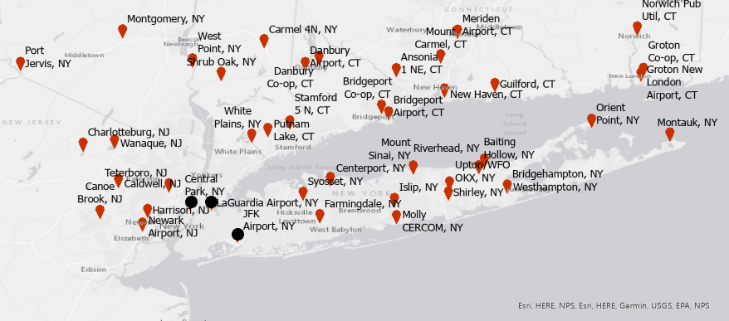
Study Site
New York and its surrounding regions
The three main weather stations that will be used are the Central Park, JFK airport, and LaGuardia airport stations. Several surrounding weather stations will be chosen to compare to NYC temperatures and precipitation.
Location of weather stations in NYC and surrounding areas
Some stations have weather data for 150 years (from 1860)

Slide 6
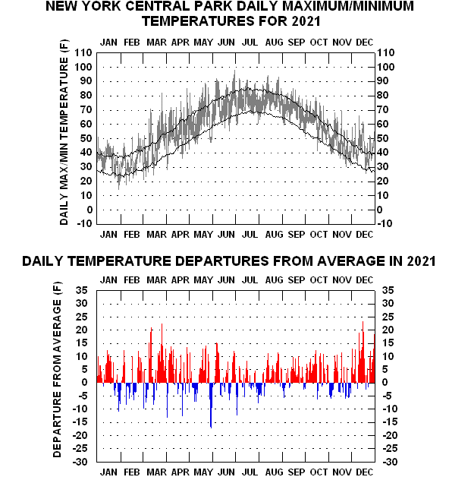
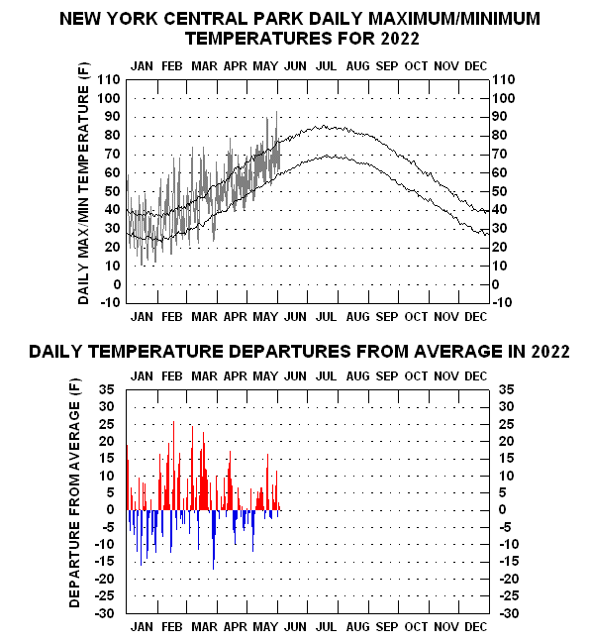
Some sample results:

Slide 7
Research Outcomes
Use data science to analyze the trend in climate change
Continued research and further analysis
Develop a manuscript for research paper

